Slide 1
Practice 5 - Global Scheduling on Multiprocessor

Slide 2
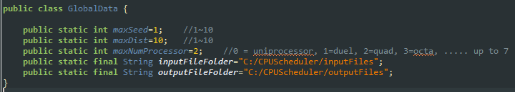
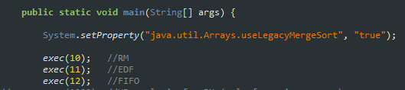
Global Scheduling on Multiprocessor
You should run global Algorithms(e.g., EDF, RM, etc.) with CPUScheduler V2
Follow the following steps
“maxNumProcessor” should be larger than 0; modify GlobalData.java as follows
Run _Exec_set.java as follows

Slide 3
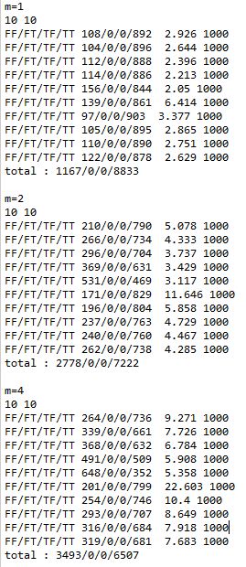
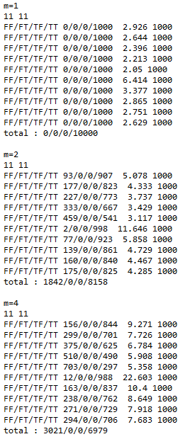
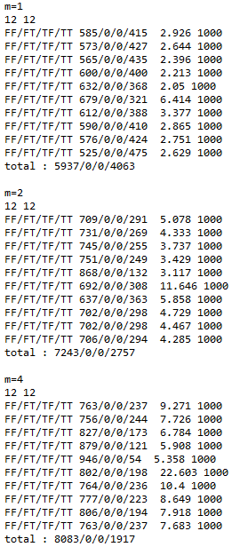
Global Scheduling on Multiprocessor
You will see the following result by executing __ResultCompare.java

